Slide 1

Project Title – Seasonal Agriculture Performance Analysis
Student Name- Saisha Yogesh Patil
College Name – Sanjivani College Of Engineering,Kopargaon
AICTE STU ID : STU6a6c2a0b419001785473547

Slide 2

PROBLEM STATEMENT
Agricultural performance changes with seasonal variations, environmental conditions, farming practices, resource availability and market conditions.
Raw agricultural data does not clearly show how agricultural performance differs between seasons.
This project aims to:
Analyze agricultural performance across seasons.
Identify important seasonal patterns and trends.
Compare yield, production and profit across seasons.

Slide 3
Project Description The Seasonal Agriculture Performance Analysis project analyzes agricultural data collected across different seasons, states, crops and farming conditions. The dataset includes: Crop and season information Farm area Rainfall and temperature Humidity and sunlight Soil conditions Fertilizer and pesticide usage Irrigation methods Analysis Process Data Collection → Data Cleaning → Exploratory Data Analysis → Statistical Analysis → Visualization → Insights → Recommendations The project objective is to identify meaningful patterns, relationships and differences in agricultural performance.

Slide 4

WHO ARE THE END USERS?
Farmers – to understand seasonal performance and improve farming decisions.
Agricultural Planners – to support seasonal agricultural planning.
Agricultural Researchers – to identify trends and relationships in agricultural data.
Government and Agricultural Departments – to support evidence-based planning.
Agribusinesses – to understand crop production and economic performance.
Data Analysts – to study agricultural trends and patterns.

Slide 5

Technology Used
Programming & Analysis
Python
Pandas
NumPy
Data Visualization
Matplotlib
Seaborn
Development Environment
Jupyter Notebook
Data Source
Seasonal Agriculture Performance Dataset

Slide 6
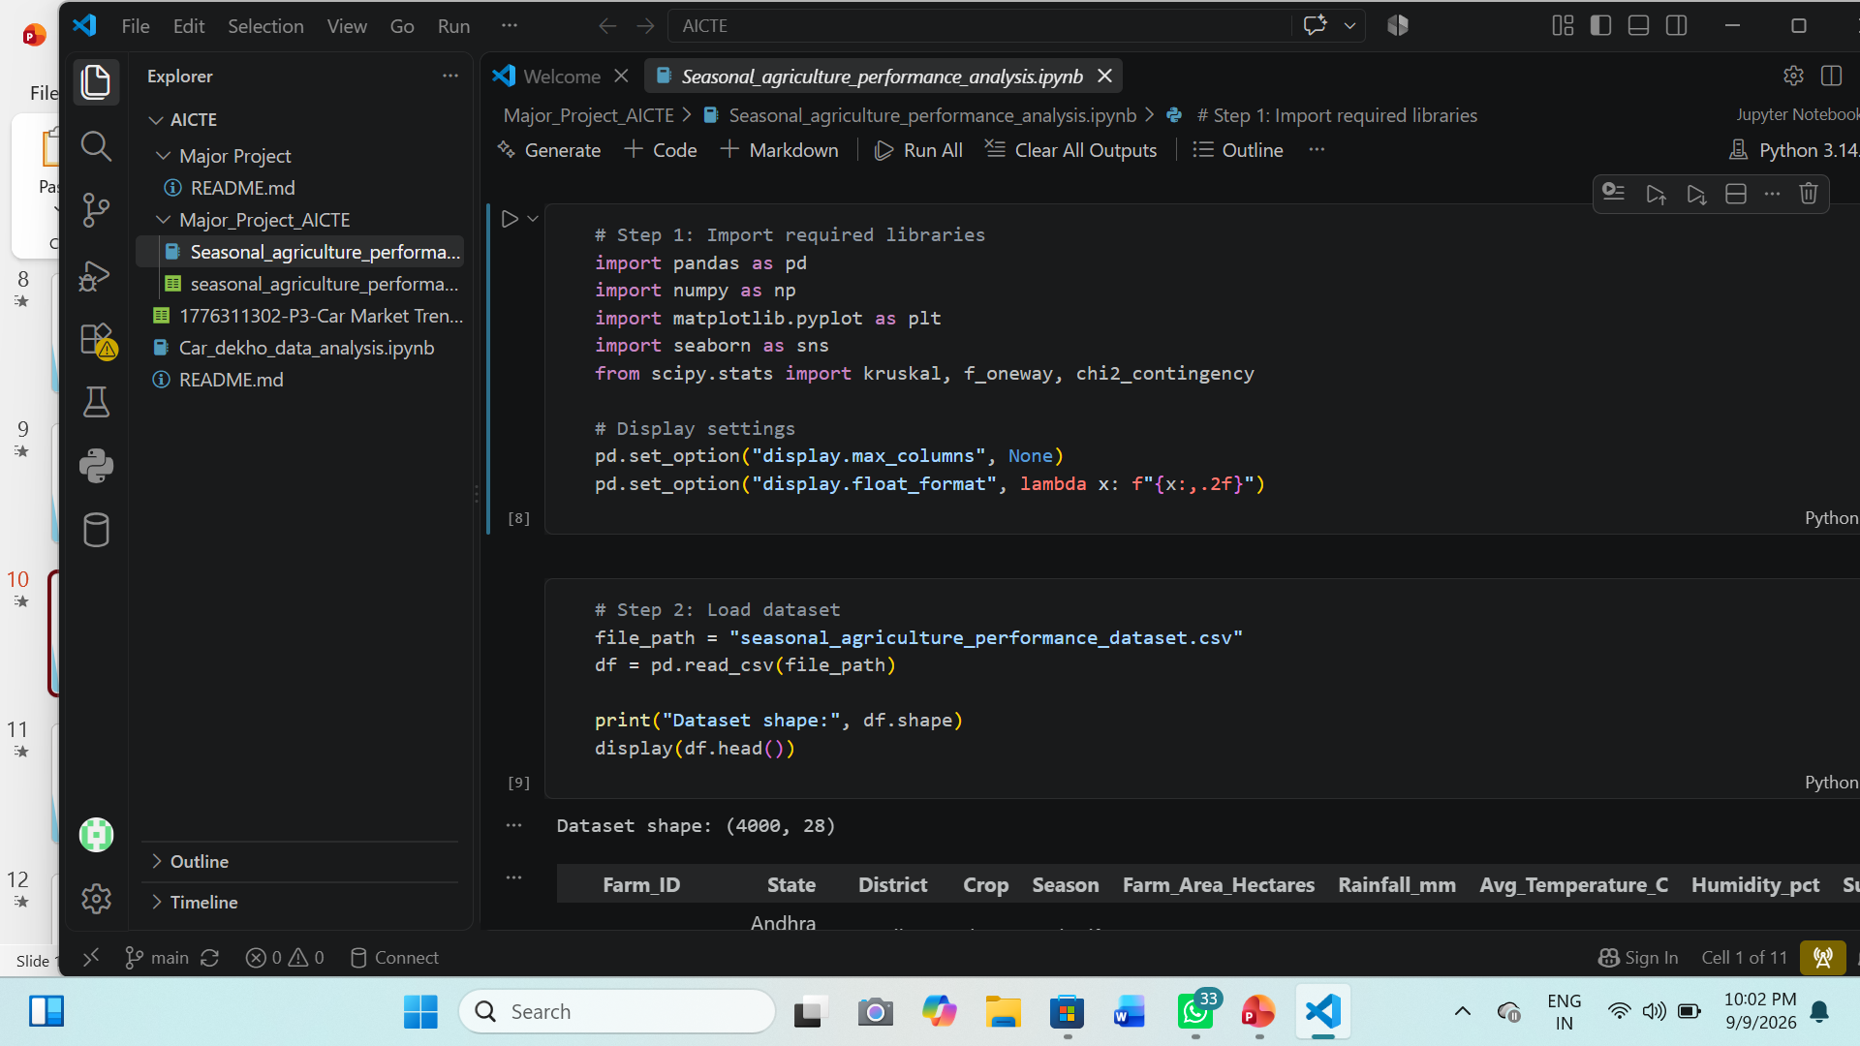
RESULTS
[Add screen shots of your code ]

Slide 7
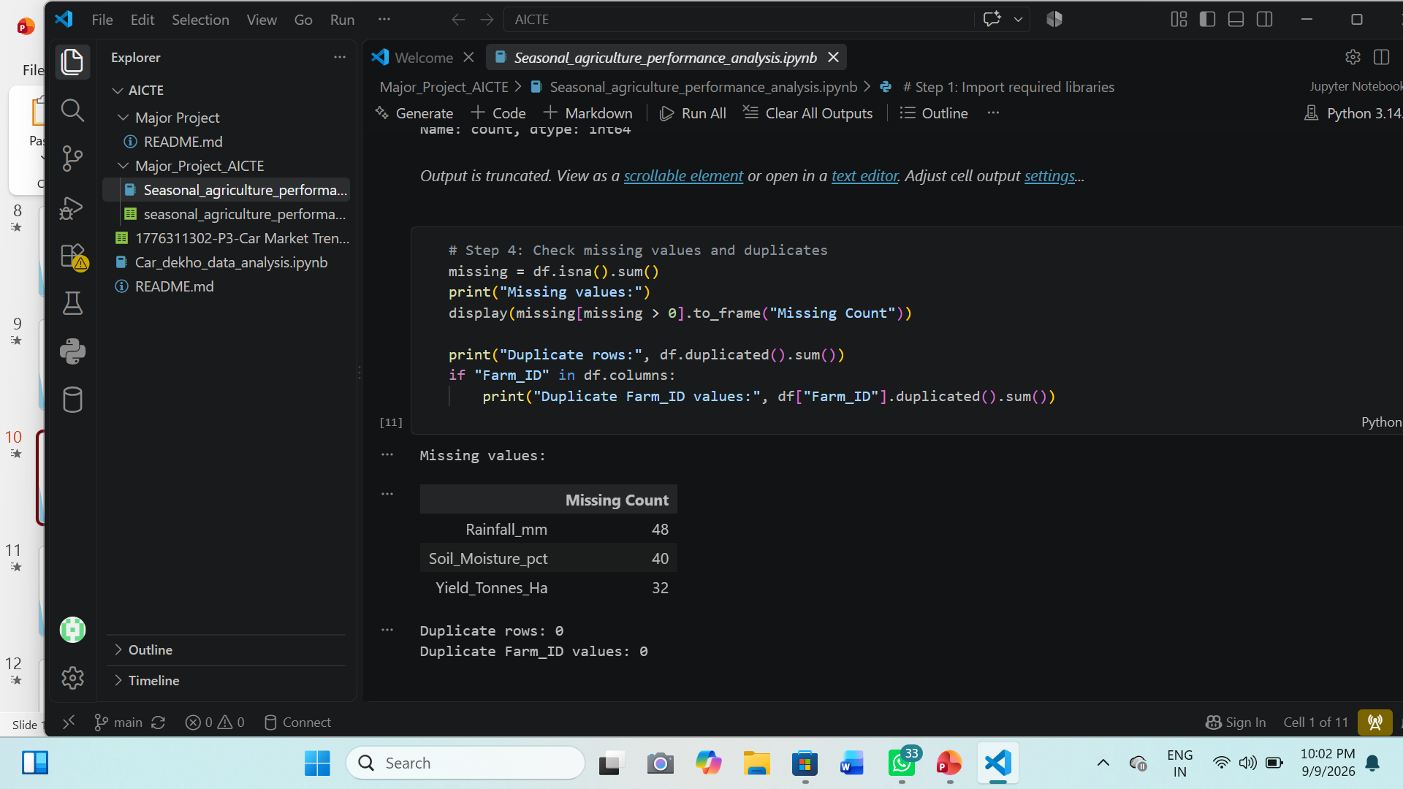
RESULTS
[Add screen shots of your code ]

Slide 8
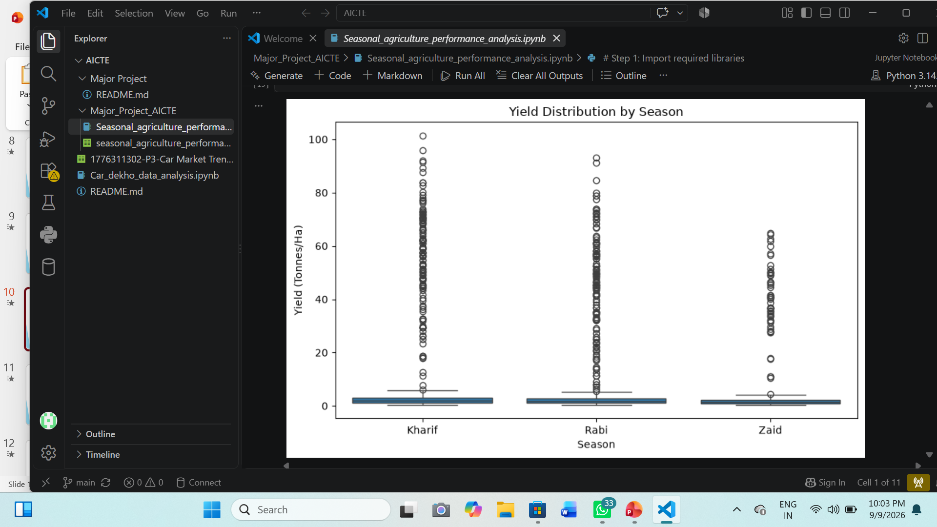
RESULTS
[Add screen shots of your code ]

Slide 9
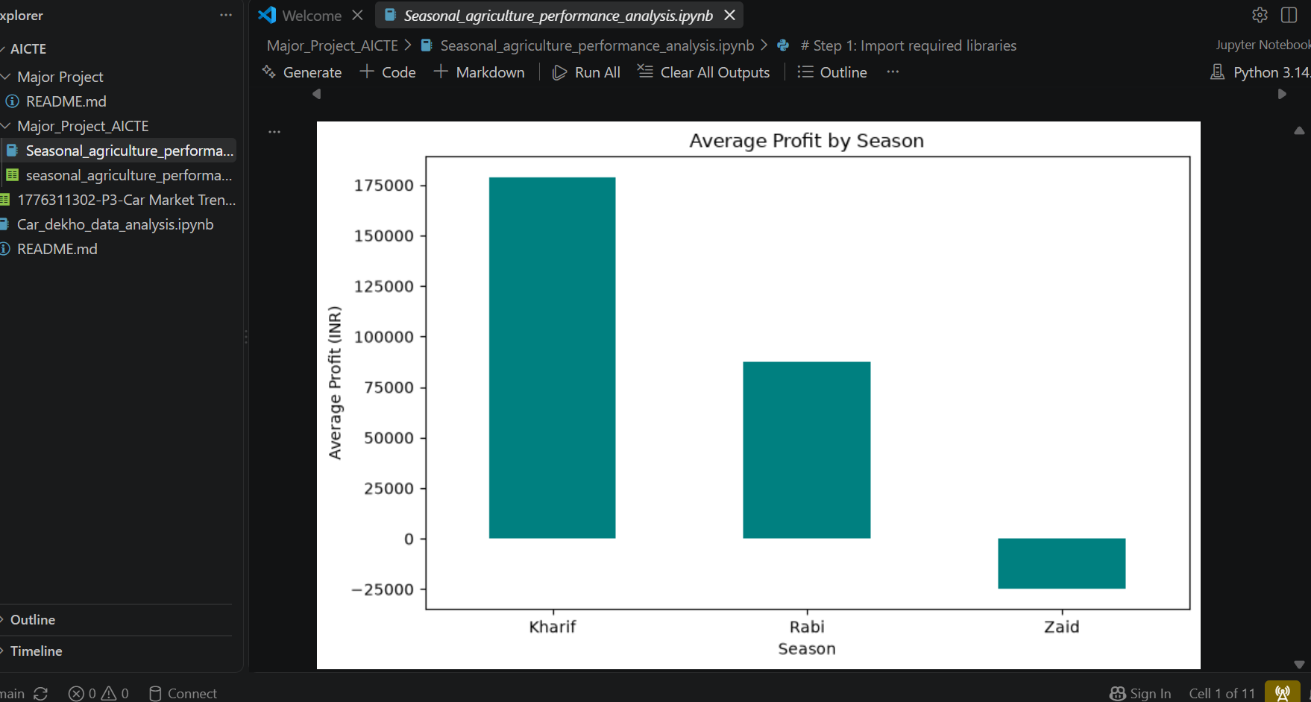
RESULTS
[Add screen shots of your code ]

Slide 10
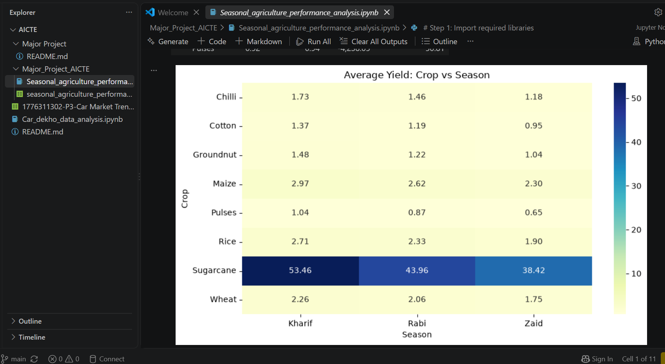
RESULTS
[Add screen shots of your code ]

Slide 11
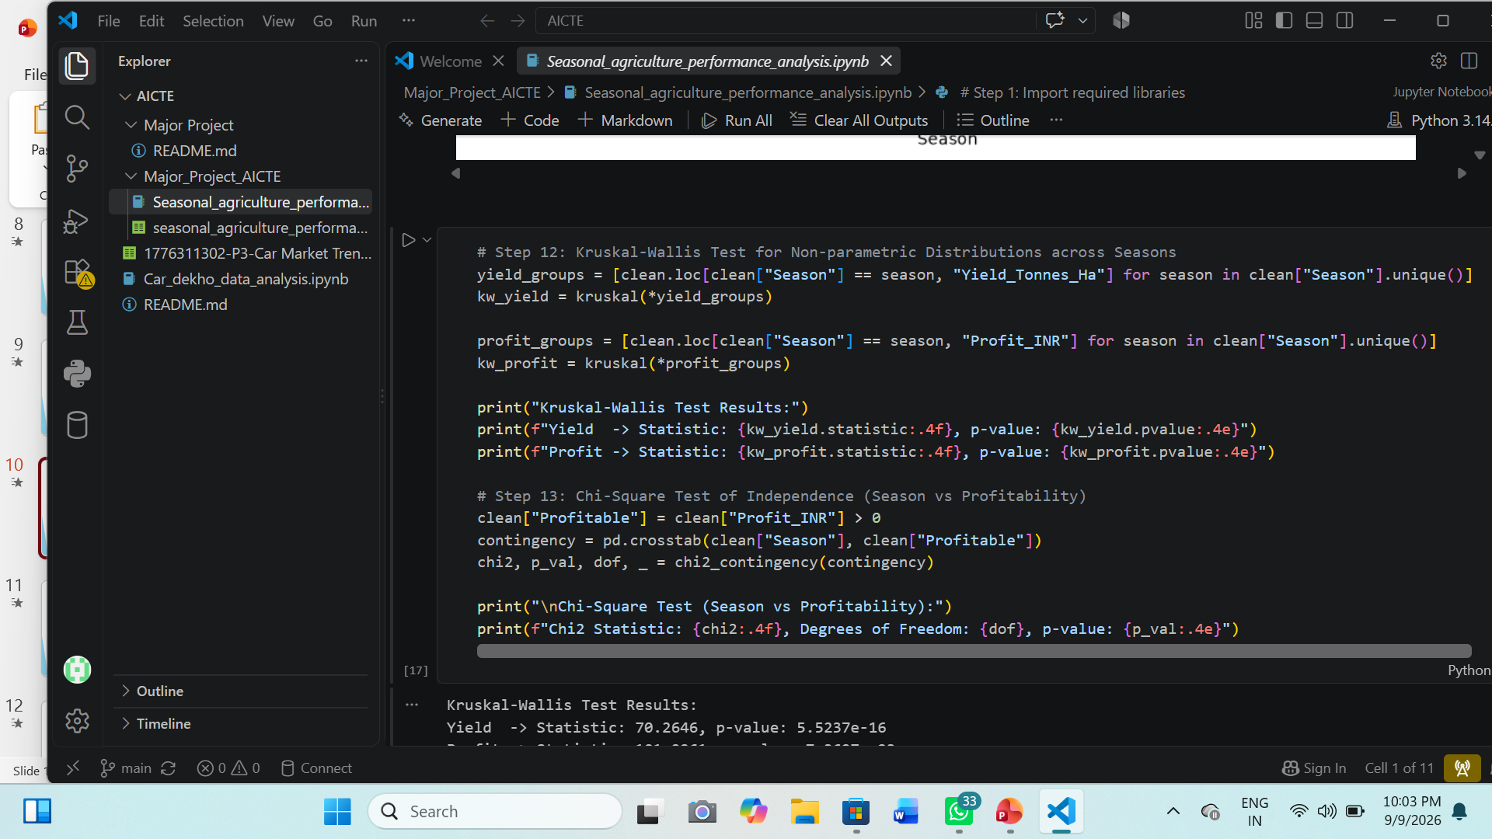
RESULTS

Slide 12
Future scope The project can be extended by: 1) Developing a seasonal crop recommendation system. 2) Using machine learning to predict crop yield 3) Predicting future agricultural profit. 4) Adding historical weather data. 5) Developing a real-time agricultural dashboard. 6) Incorporating soil and weather forecasts. 7) Studying more regions and crop varieties. 8) Developing early-warning models for disease and pest risks. 9) Supporting better water and resource management. The project specification also expects evidence-based recommendations and identification of areas requiring further investigation.

Slide 13
GitHub Link
https://github.com/patilsaisha1404-dot/AICTE_VOIS_Fortech_Internship

Slide 14
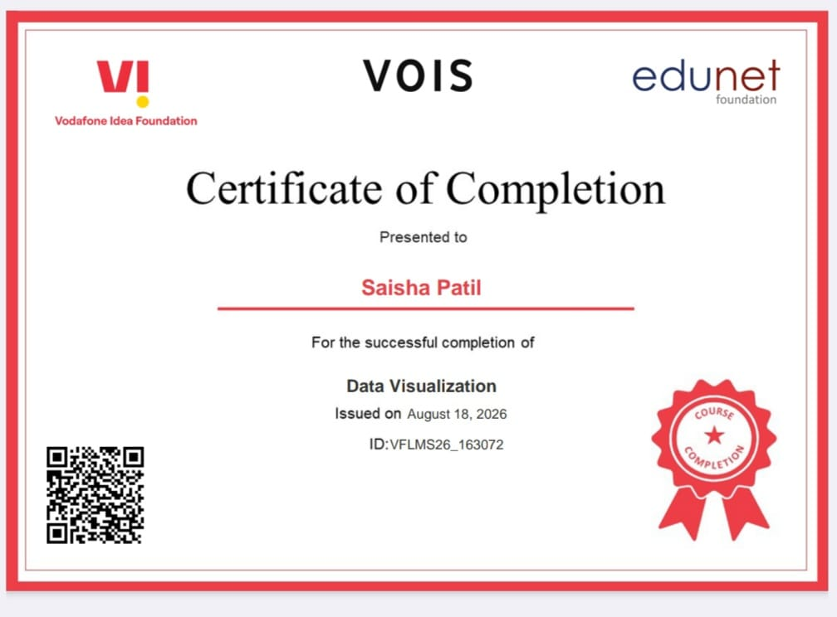
VOIS Course completion certificate - Course name- Data Visualization

Slide 15
Thank you
.
.

